Slide 1
CREDIT CARD FRAUD DETECTION
Nabil bin Zamzamzairani

Slide 2


TABLE OF CONTENT
01
02
03
04
05
INTRODUCTION
IMPLEMANTATION
EVALUATION
SUMMARY FINDINGS
STATISTICAL ANALYSIS
Imbalance Data &
Correlation
Chosen Model
and Data Flow
MLOps
and Deployment
Results,
Cost Benefit Analysis
and Conclusion
Problem statement, Objective, Data, Metrics

Slide 3
Introduction
Problem Statement
The alarming increase in fraudulent credit card usage has stressed the fraud management systems currently in use in banks which effects accuracy (Oluwole, 2023)
Objective
To Detect fraudulent credit card transactions.
To Compare machine learning models.

Slide 4
Introduction
Data
The project makes use of the dataset downloaded from:
www.kaggle.com
The data set includes credit card transactions made by European cardholders over a period of two days in September 2013. Out of a total of 2,84,807 transactions, 492 were fraudulent. This data set is highly unbalanced, with the positive class (frauds) accounting for 0.172% of the total transactions.

Slide 5
Introduction
Data
Table 1. Data Definition
Feature | Description
Time | Seconds elapsed between the first transaction in the data set and the subsequent transactions
Amount | To compare the best model the produce the least False Positive
V1 – V28 | The principal components obtained using PCA due to privacy
Class | The transaction amount

Slide 6
Introduction
Metrics
Table 2. Metrics
Metrics | Description
Accuracy | To compare the best model to accurately predict fraudulent transaction
Precision | To compare the best model the produce the least False Positive
ROC score | To compare the performance of a classification model at all classification thresholds.

Slide 7
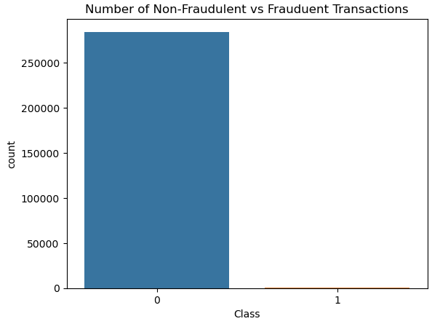
Summary Findings
Imbalance Data
The Dataset is heavily biased. This is shown in the table below:
Table 3. Non-Fraudulent vs Fraudulent Transaction
Non- Fraudulent | Fraudulent
284,315 | 492
Due to this, random over sampling was used to balance the data.
Figure 1

Slide 8
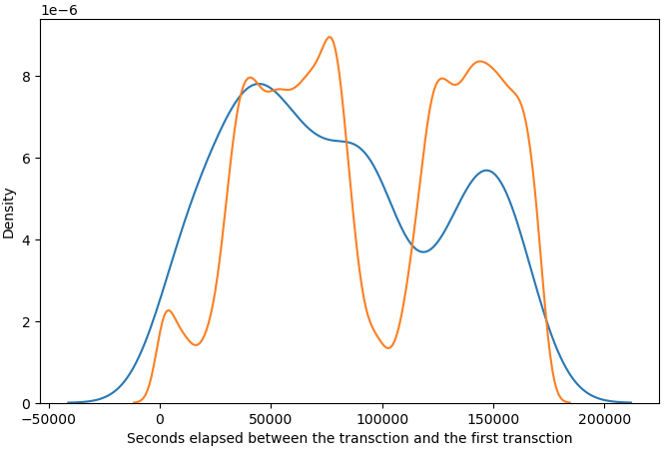
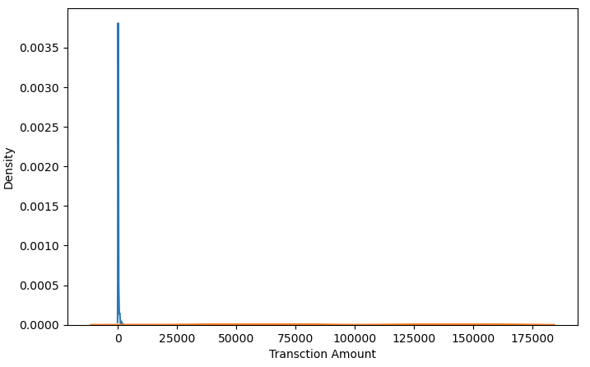
Summary Findings
Correlation
Time have a negative correlation with class and the distribution of classes with time have no pattern as shown in Figure 2. While Amount have a positive correlation and the distribution of classes with amount can be seen that fraudulent transaction is only low amount, as shown In Figure 3. Thus, We drop Time and use Amount as a variable.
Figure 2: Distribution of Class with Time
Figure 3: Distribution of Class with Amount

Slide 9
Statistical Analysis
Chosen Model
The Model that was chosen for this project is Logistic Regression, Decision Tree, and Neural Network.
SVM, Random Forest and KNN was not chosen. The reason why SVM and Random Forest is not very efficient with large number of datapoints beacuse it takes lot of computational power and resources to make the transformation. While KNN is not memory efficient. It becomes very slow as the number of datapoints increases as the model needs to store all the data points.

Slide 10
Statistical Analysis
Data Flow
Exploratory data analytics (EDA)
Data Understanding
Train/Test Split
Model-Building/Hyperparameter Tuning
Model Evaluation
Figure 4. Flow Of Data

Slide 11
Statistical Analysis
Data Flow
Logistic Regression
Importing the necessary packages.
Finding the optimal hyperparameter C.
Fit model with the optimal hyperparameter C.
Training the data using the LogisticRegression()
Calculate the fraud transaction and valid transactions, the calculating the ROC, precision, and accuracy.

Slide 12
Statistical Analysis
Data Flow
Decision Tree
Importing the necessary packages.
Finding the optimal hyperparameters.
Fit model with the optimal hyperparameters.
Training the data using the DecisionTreeClassifier()
Calculate the fraud transaction and valid transactions, the calculating the ROC, precision, and accuracy.

Slide 13
Statistical Analysis
Data Flow
Neural Network
Importing the necessary packages.
Training the model using the tf.keras.Sequential().
Compile Model.
Fit model and train the data.
Calculate the fraud transaction and valid transactions, the calculating the ROC, precision, and accuracy.
Check for overfitting.
Regularization & Dropout Training to adjust overfitting.
Calculate the fraud transaction and valid transactions, the calculating the ROC, precision, and accuracy.

Slide 14
Implementation
Machine Learning Operations (MLOps)
Scoping
Data Engineering
Modelling
Monitoring
Deployment
Figure 5. Machine Learning Cycle (Nayak, 2023)

Slide 15
Implementation
Deployment
Infrastructure Setup
Cloud vs On-Premises
Hardware: Choose hardware that can support the computational demands of neural networks, such as GPUs for parallel processing.
Software: Install the necessary operating systems, drivers, and libraries that are compatible with the machine learning frameworks you’re using.
Cloud-Based Deployment: Utilize cloud services for scalability and flexibility. Services like AWS, Google Cloud, and Azure offer machine learning-specific infrastructure.
On-Premises Deployment: For sensitive data, an on-premises solution might be preferred. This requires setting up and maintaining your own servers and hardware.

Slide 16
Implementation
4.2 Deployment
Infrastructure Setup
Cloud vs On-Premises
Containerization
Hardware: Choose hardware that can support the computational demands of neural networks, such as GPUs for parallel processing.
Software: Install the necessary operating systems, drivers, and libraries that are compatible with the machine learning frameworks you’re using.
Cloud-Based Deployment: Utilize cloud services for scalability and flexibility. Services like AWS, Google Cloud, and Azure offer machine learning-specific infrastructure.
On-Premises Deployment: For sensitive data, an on-premises solution might be preferred. This requires setting up and maintaining your own servers and hardware.
Use containerization tools like Docker to create a consistent and isolated environment for your model. This simplifies dependencies management and makes the deployment process reproducible.

Slide 17
Implementation
4.2 Deployment
Register the Model: Save the trained model in MLOps tool so it can be accessed in other projects or deployed.
Prepare Entry Script and Dependencies:
Entry Script (score.py): This script is responsible for loading the trained model, processing input data, performing predictions, and returning the results.
Dependencies File (conda_env.yaml): Specifies the necessary pip and conda packages required by your service.
Configure the Deployment:
Define the compute target where the model will be deployed.
Configure the entry script and dependencies file.
Set up the deployment configuration with the required CPU, memory, and other settings.

Slide 18
Implementation
4.2 Deployment
Deploy the Model:
Deploy the model to the chosen compute target.
Test the Deployment:
Once deployed, test the endpoint to ensure it’s working correctly by sending sample requests and verifying the responses.
Monitor and Manage the Endpoint:
Use monitoring tools to keep track of the model’s performance and health.
Manage the endpoint through scaling, updating, or redeployment as needed.

Slide 19
Evaluation
Results
Out of the three models (Logistic Regression, Decision Tree, Neural Network), it was found that Neural Network have the highest and ROC. Even though Neural Network accuracy is lower than Decision Tree but the difference is too minute to make an Impact as shown in Figure 2
Table 4. Findings Metrics
Algorithms | Accuracy | Precision | ROC
Logistic Regression | 0.94 | 0.97 | 0.99
Decision Tree | 0.95 | 0.96 | 0.97
Neural Network | 0.94 | 0.98 | 1.00

Slide 20
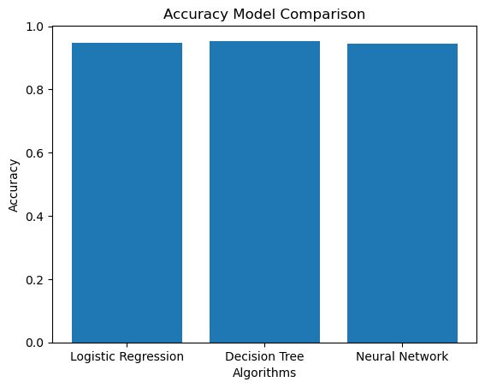
Evaluation
Results
Even though Neural Network accuracy is lower than Decision Tree but the difference is too minute to make an Impact as shown in Figure 2
Figure 6

Slide 21
Evaluation
Cost Benefit Analysis
While picking the best performing model is important, there are also other factors that need to be considered when choosing the best machine learning models. These factors are whether we have the required resources, infrastructure or computational power to run the model or not (Ileberi et al., 2022).
Even though Neural Network is the best model comparatively financial institutions need to consider the cost of deploying Neural Network as a model. This is because, for computing complex models the deployment cost will be high. On the flip side, simple models like Logistic Regression have a lower cost due to requiring less computational resources.

Slide 22
Evaluation
Conclusion and Recommendation
In conclusion, Neural Network is the best Model but if resources are limited, Logistic Regression is also a good option as the simplistic nature of Logistic Regression makes the resources needed lesser thus, making the cost lower.

Slide 23
Reference
Ileberi, E., Sun, Y., & Wang, Z. (2022). A machine learning based credit card fraud detection using the GA algorithm for feature selection. Journal of Big Data, 9(1). https://doi.org/10.1186/s40537-022-00573-8
Nayak, Y. (2023, June 26). A gentle introduction to MLOPs - towards data science. Medium. https://towardsdatascience.com/a-gentle-introduction-to-mlops-7d64a3e890ff
Oluwole, O. (2023). PREDICTIVE ANALYTICS ON CREDIT CARD FRAUD DETECTION USING CLASSIFICATION MODELS. ResearchGate. https://doi.org/10.13140/RG.2.2.26369.02404

Slide 24
Thank you

Slide 25
Appendix

Slide 26
Appendix
For reference of the modeling here is the link to the handling of data and modeling: https://github.com/Nabz3/Credit-Card-Fraud-Detection.git

